Slide 1
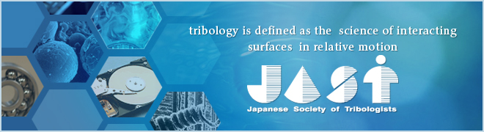
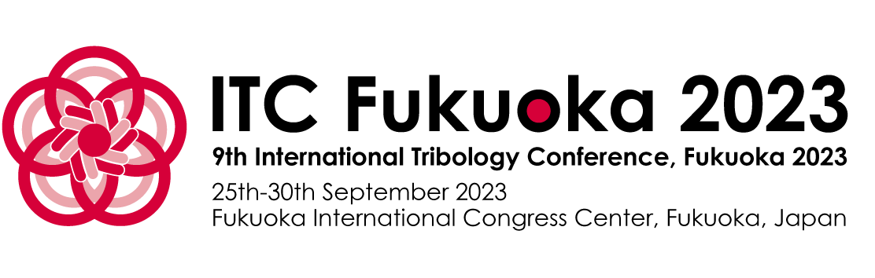
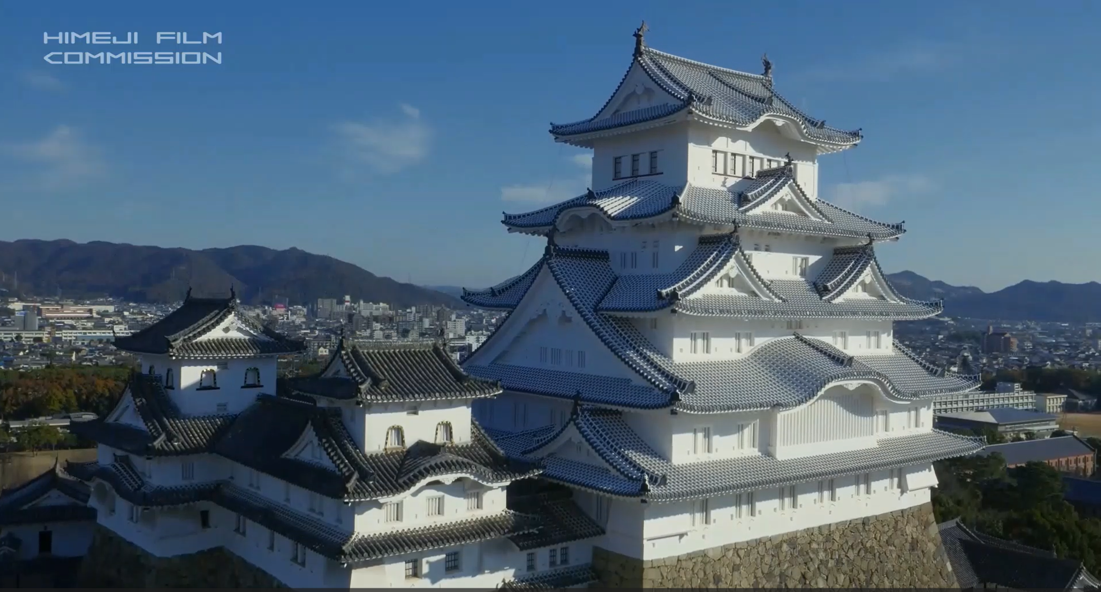
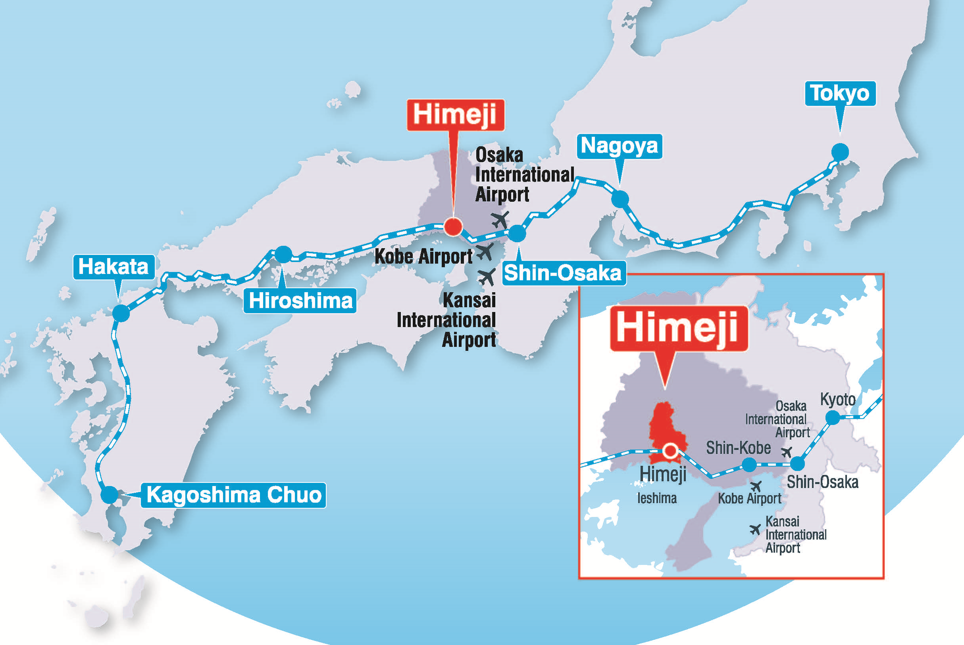
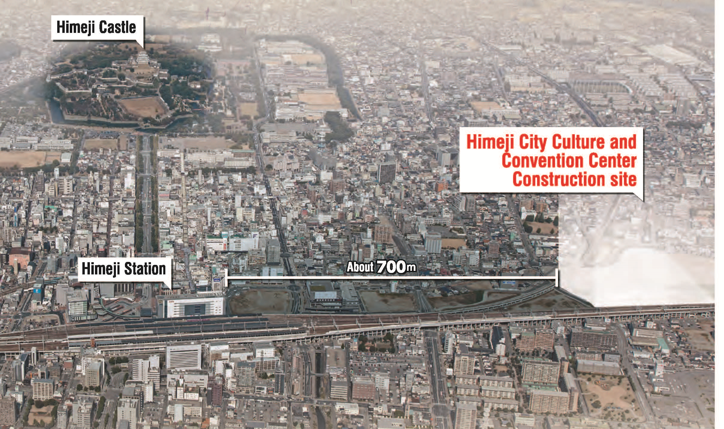

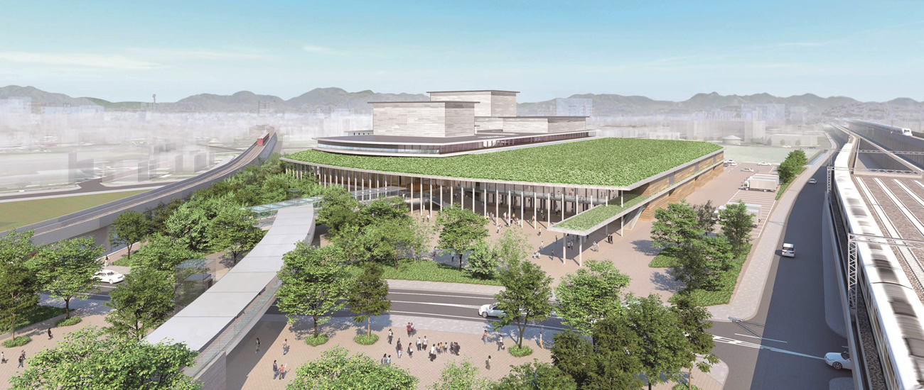
10th ITC Himeji 2027 September 19-24, 2027
3 hours
Hyogo
Prefecture
2 hours
Fukuoka
30min
10 min walk from Shinkansen Station
Beppu
Hyogo
Prefecture
Convention Center
Arcrea HIMEJI
Opened in 2021!
Awaji island
Please follow the website of
the Japanese Society of Tribologists
https://www.tribology.jp/indexe.htm

Slide 2
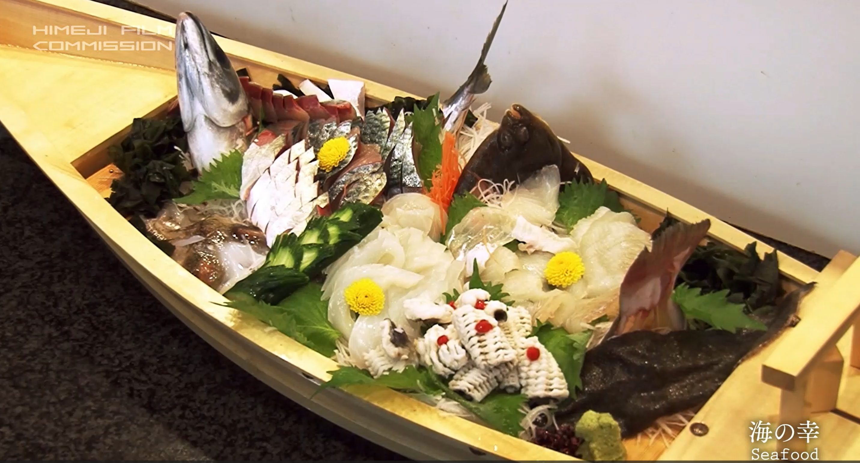
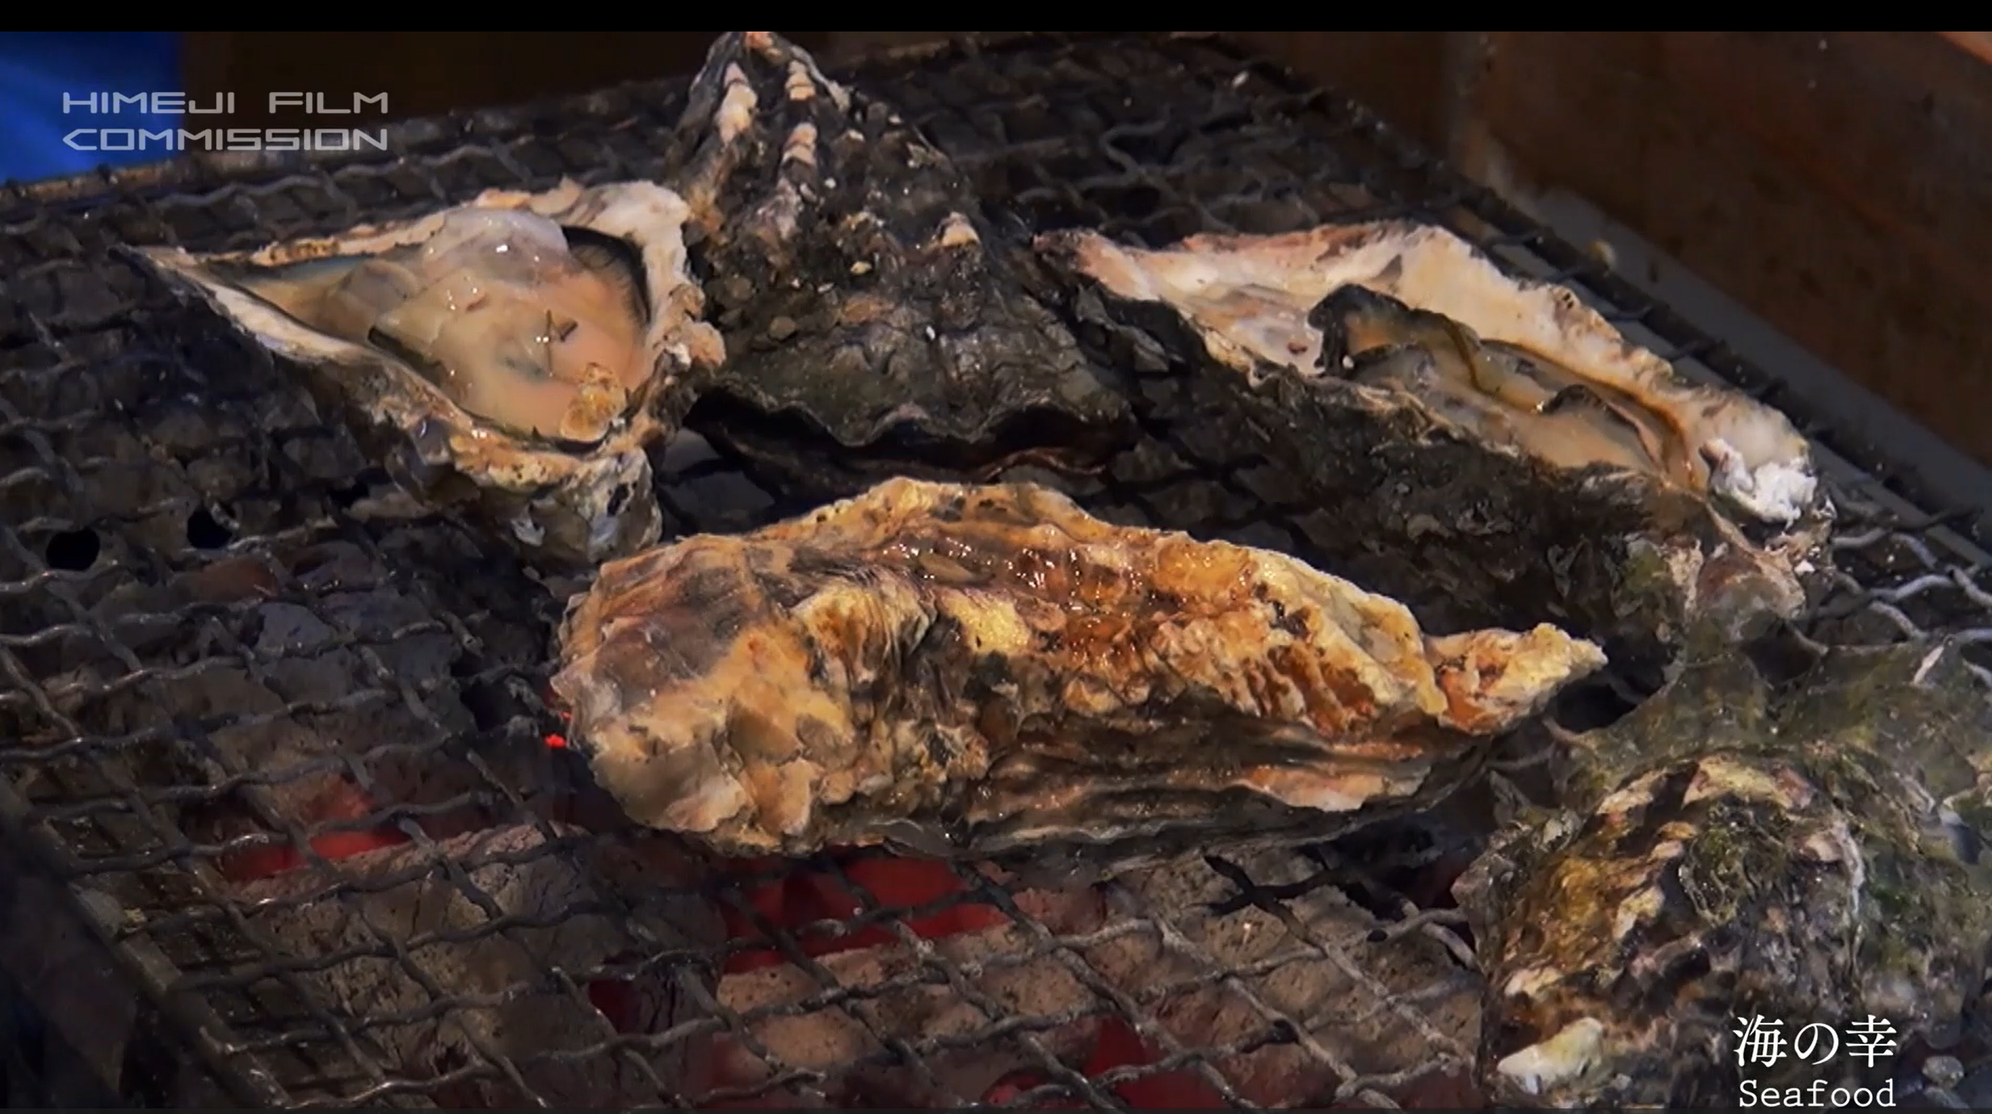
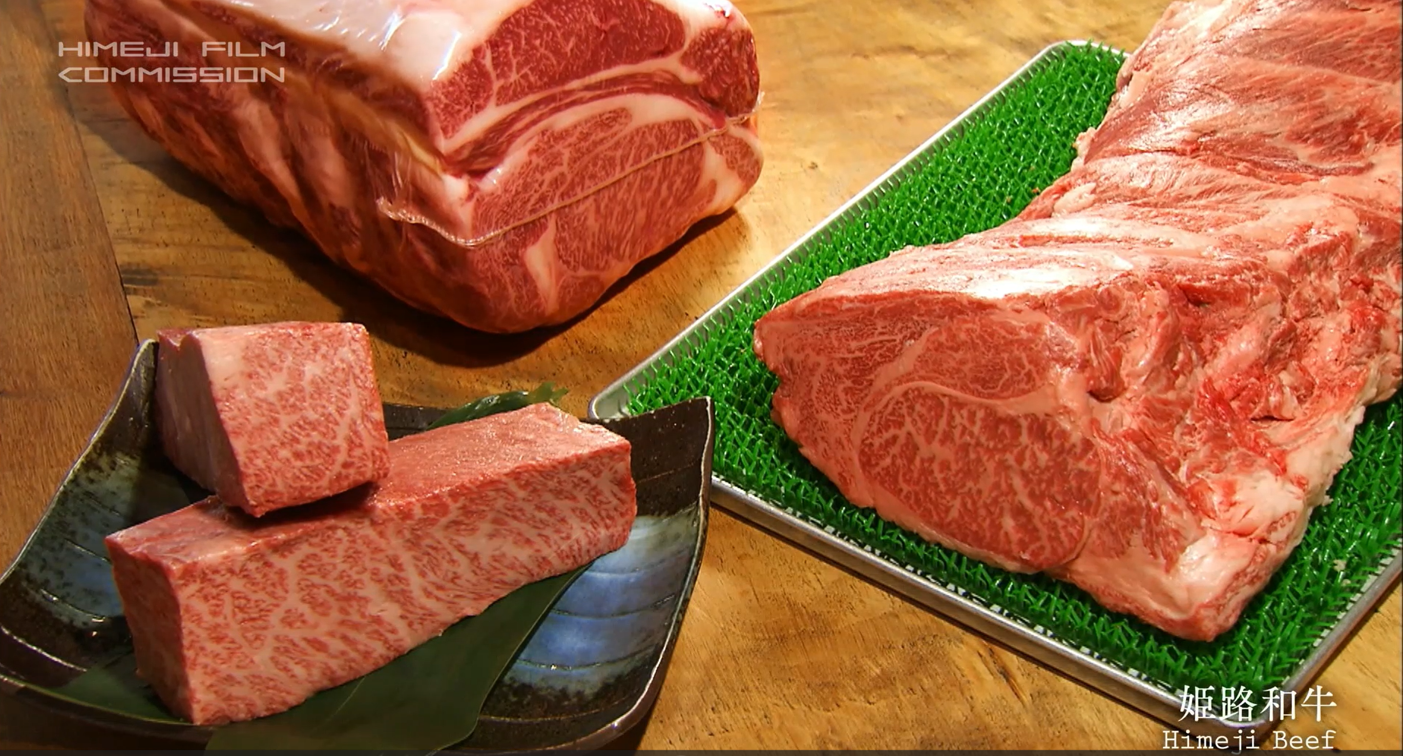
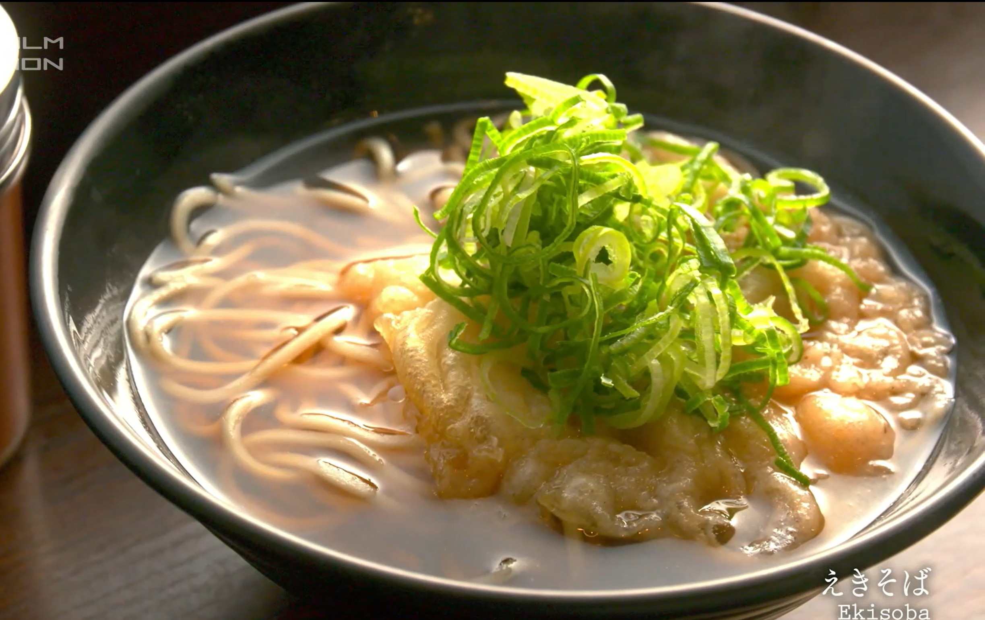
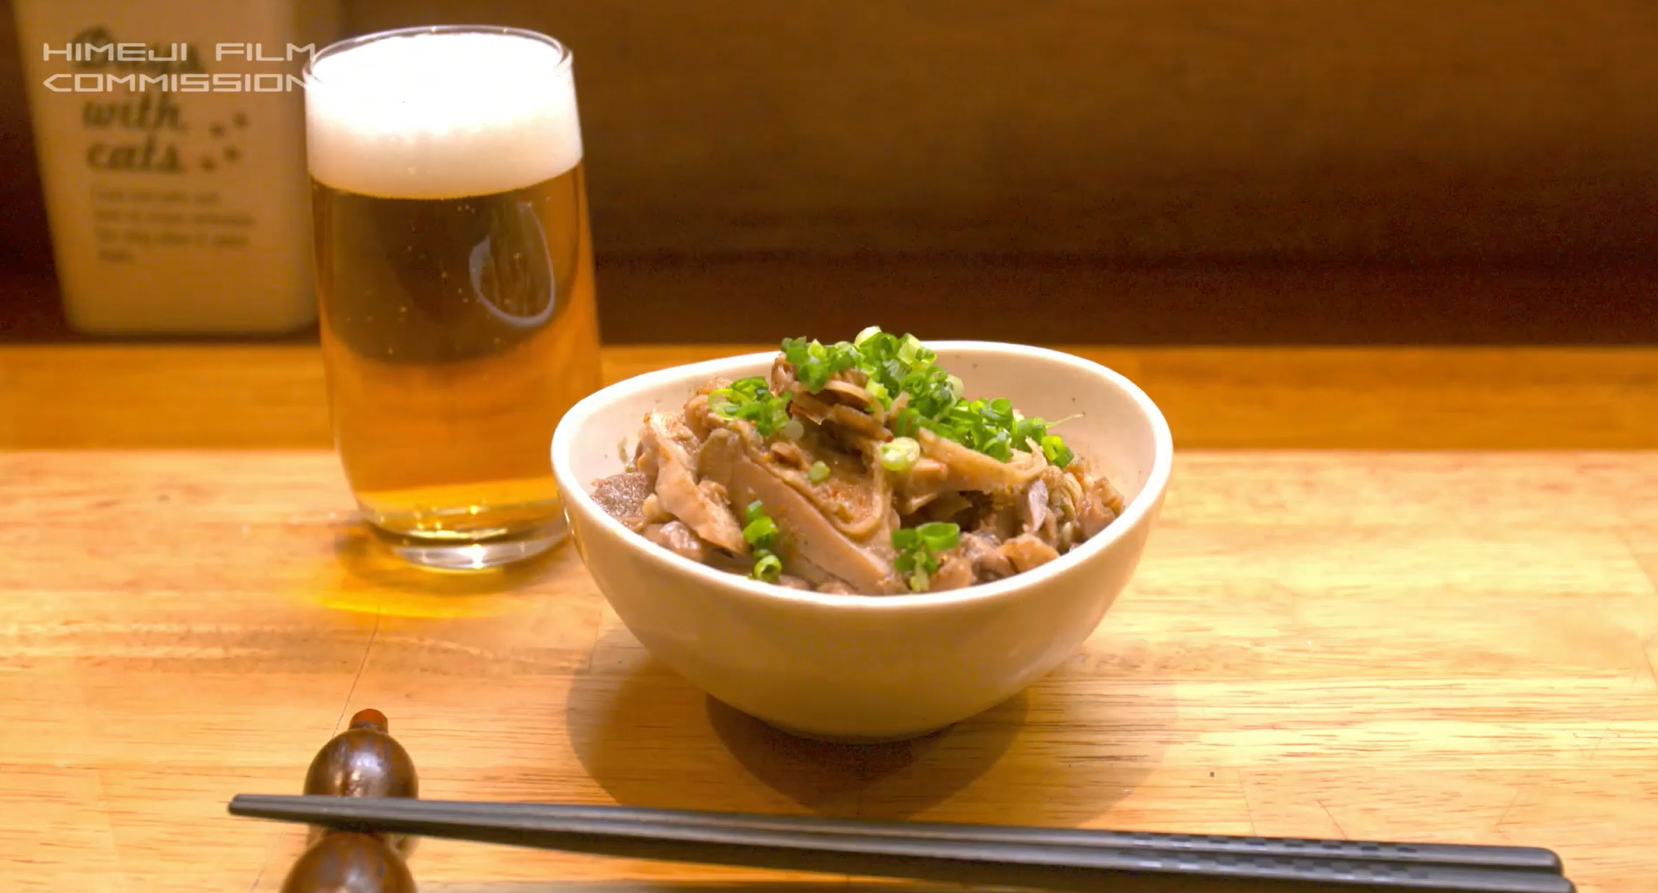
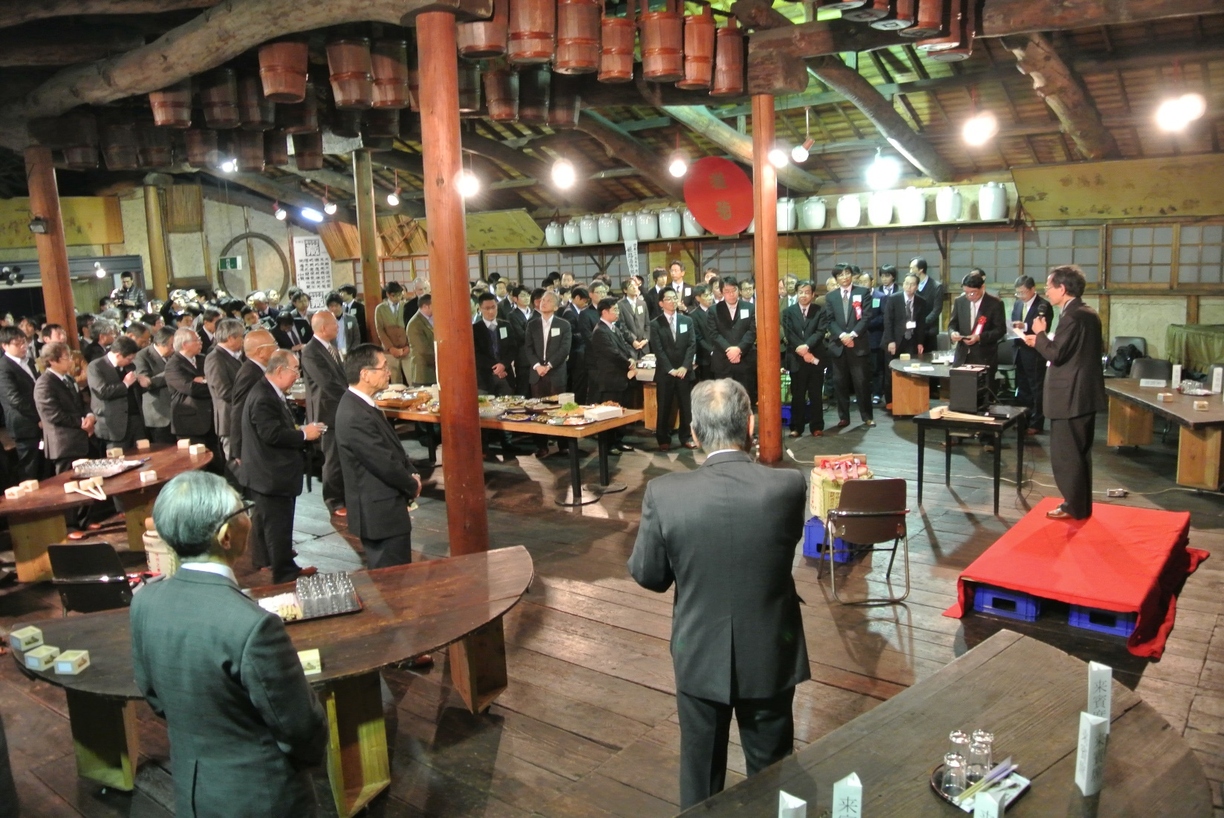
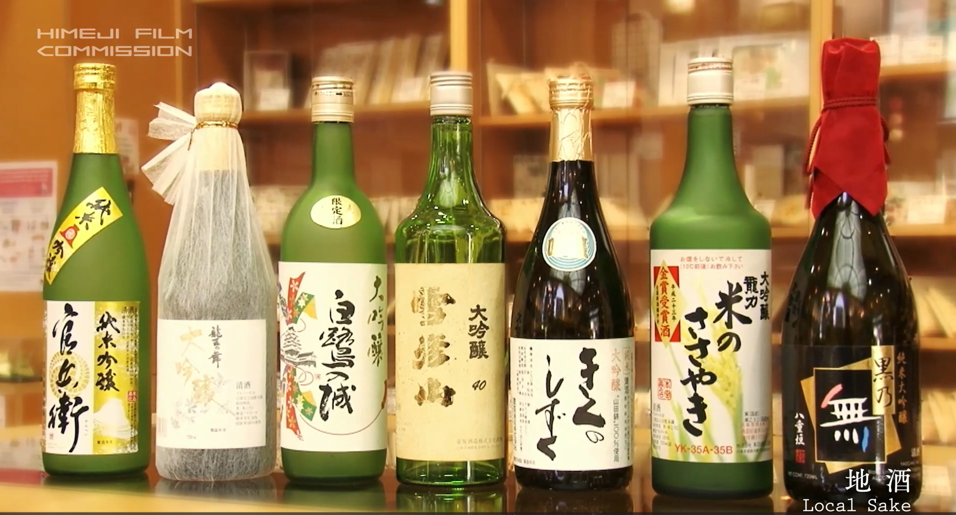
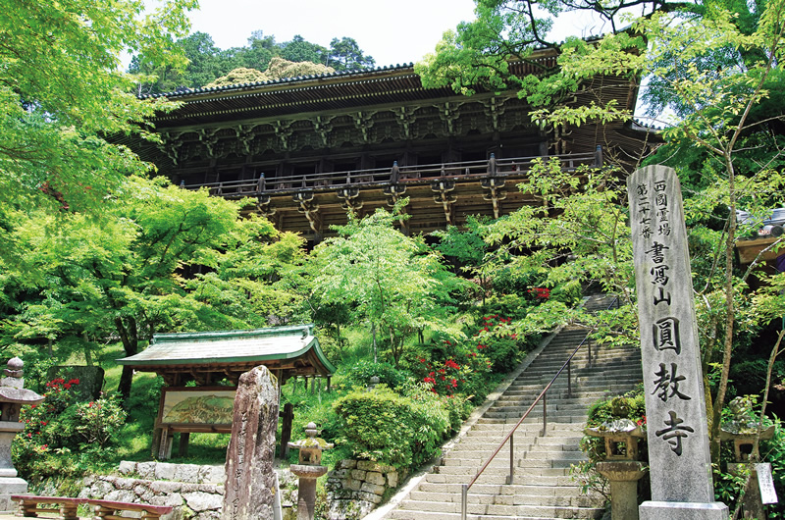
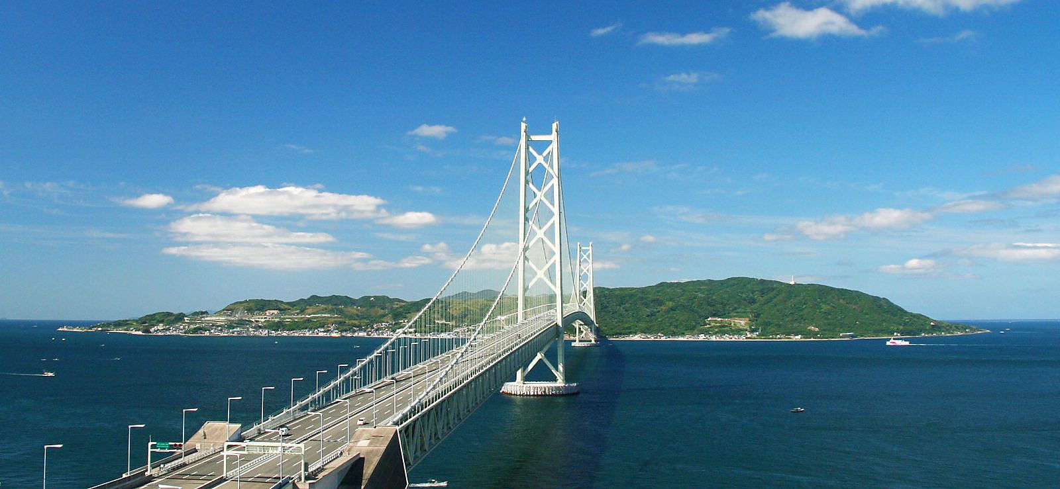
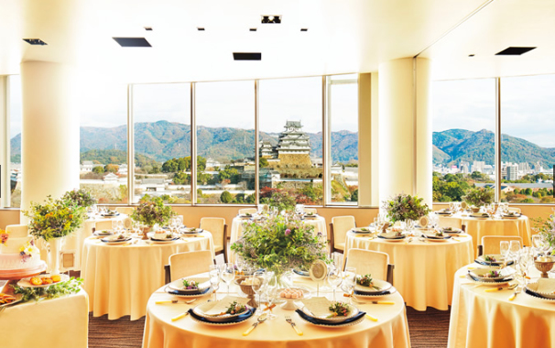
World Heritage
Himeji castle is the most beautiful castle among the 5 national heritage castles.
10th ITC Himeji 2027
September 19-24, 2027
Sea Food
Of course delicious!
The Origin of Japanese Beef (Kobe Beef)
Local Food
For deep Japanese food lovers.
98 % of Japanese beef is Tajima beef cattle (top quality = Kobe beef) , since eating beef in Japan started in 1860s, when the Kobe port opened.
The Origin of Japanese Sake
Clear Sake is born by adding ash, in 1600s at Hyogo prefecture. 56 % of Sake is made by “Yamadanishiki” Japanese rice created(1923) and grown in Hyogo.
The Last Samurai
The Origin of Japan
(Awaji Island)
Let’s discuss the Origin of Friction!
According to old Japanese myth (published in 712, 720), Awaji island is the first god-created island.
Hollywood film “the last samurai” was taken here.

